Slide 1
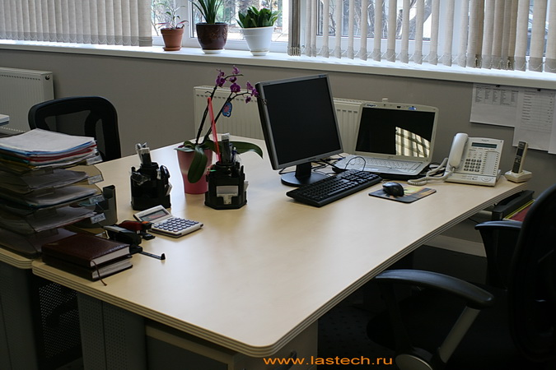
Profession Manager
Profession Manager
Work of the teacher of Eliseeva.O.M.

Slide 2

The manager it not to be simple as well as it isn't really easy to be the seller. The profession of the manager is responsibility. It isn't simple to be able to sell it, also and ability предствалять that that the person wants to buy it.

Slide 3

Manager's form such. It isn't simple to put on a uniform and to come to work, it also adequately to fulfill the day at the position.

Slide 4

The sales manager is not only the seller. It, the most important, the person who has to advertize the goods.

Slide 5
Work of the head of sales or senior manager consists in the following:
· Staff recruitment, training in skills of sales;
· Performance of a sales plan, control of its execution, creation of the motivational scheme;
· Distribution of client base between managers (segmentation);
· Control of overall performance of team;
· Preparation of reports before the higher head;
· Interaction with other staff of the company;
· Tracking of activity of the competing companies, tendencies of the market.

Slide 6
The sales manager is obliged to carry out communication between buyers, the trade and making organizations. The profession is widespread in the sphere of wholesale trade. Allocate the following specializations of sales managers depending on a type of object of sale: consumer goods; production of industrial function; services.

Slide 7

After the 9 th or after the 11 th each person chooses to himself a profession, here and I chose the specialty, from it my future, I think choosing the manager's profession I wasn't mistaken. I wish all to choose that profession for what you are going to work, but not on that what to you offer, and it is profession you not to be pleasant, it can and prestigious but you will be able to work at that work which to be pleasant to you. With a great effort to force itself, I think, isn't necessary.

